Slide 1
Lesson 3: What is my passion and how does it fuel me?
FOR MORE LESSONS LIKE THIS, CHECK OUT OUR FAMOUS MINDSET MASTERY SEL CURRICULUM AT
https://www.legacymasteryacademy.org/sel-curriculum
Module 6: Living With Purpose

Slide 2
General:
Computer
LCD Projector
Speakers
Handouts and Materials:
Passion Day Assignment Students will need this completed from the last lesson. Teachers: Have your passion demonstration ready for this lesson!
Passion Day Note Tracker 1 per student
Create a binder labeled “Passion Binder” so students can store their passion day assignments. It can be stored somewhere in the classroom where students can peruse and gain inspiration.
Teacher
Materials

Slide 3
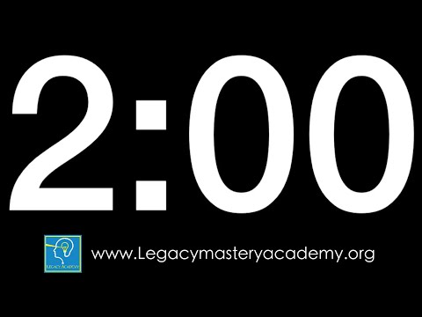
DO NOW Complete quietly in your binder notes
Review your Passion Day homework responses to the 6 questions you will be sharing today. (2min)
(Use this as extra preparation time for your Passion Presentation)
2min
Notes:
2min T=2min
(3min Individual Write: “Good morning students, I’m so excited for our lesson today. Let’s get started on our do now. We will use our Do Now time to review our passion day homework responses to the 6 questions you will be sharing for today. Use this time time also to prepare for sharing your passion with your family members. We will be learning a lot from each other.”
Extension opportunity:
Give more time as needed for students to prepare.

Slide 4
Lesson 3: What is my passion and how does it fuel me?
Module 6: Living With Purpose
1min
Notes:
1min: T=3min
20 sec: Have a student read the essential question. “_______, can you read the essential question for us? Thank you!” “Think about why this topic today is important for you. How will answering this lesson question benefit you?”

Slide 5
Why Passion Day?
Remember, a purpose must have the following 3 requirements. It is:
A. Long-term mission in life where you use
B. Your passion/s: Something you love, find meaningful, and that energizes you
C. To serve others and make a difference in their lives
Today we are going to explore the second requirement, Passion! By exploring it within ourselves and others, we will begin to see its power in driving us to do amazing things!
1min
Notes:
1min: T=4min
1min: Framing the Day: “Let’s review what a purpose is according to the research. A purpose must have the following 3 requirements: A. A long term, far horizon direction that is B. Personally meaningful, that is C. inspired by a desire to make a difference beyond your yourself. In other words, a purpose is A. Your lifelong mission where you use B. Something you absolutely love to do for yourself C. In order to make a difference in the lives of the others. Today we are going to explore the second requirement, Passion! By exploring it within ourselves and others, we will begin to see its power in driving us to do amazing things!

Slide 6
Passion Day Instruction
PRESENTER: (3min)
Demonstrate and explain your talent, interest, or passion through pictures, video, or live.
Address the 6 questions on the Passion Assignment Handout
Teacher: “Let’s review the instructions for today and then we’ll follow these instructions as I present to you my personal passion.”
MY PASSION
LISTENERS: (3min)
During Presentation:
SLANT, Actively Listen, and Do Not Interrupt the speaker.
Jot down anything interesting ideas in the Passion Day Note Tracker.
After Presentation:
Ask clarifying/curiosity questions (90 sec): “I’m curious about__.”
Compliment & Appreciate (90 sec): “I appreciate…”
1min
Notes:
1min: T=5min

Slide 7
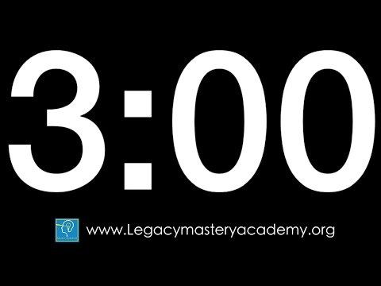
Our Teacher’s Passion
PRESENTER: (3min)
Demonstrate and explain your talent, gift or passion through pictures, video, or live.
Address the 6 questions on the Passion Assignment Handout
LISTENERS: (3min)
During Presentation:
SLANT, Actively Listen, and Do Not Interrupt the speaker.
Jot down anything interesting ideas in the Passion Day Note Tracker.
After Presentation:
Ask clarifying/curiosity questions (90 sec): “I’m curious about__.”
Share positive comments & gratitudes (90 sec): “I really liked … Thank you for/I appreciate…”
7min
Notes:
7min T=12min
3min: Teacher shares their passion with students for three minutes.
Teacher Note: Use this opportunity to share your passion with students. Follow the same format and answer the following format as you present. You can create your own slide/s on a separate powerpoint showing your gift, passion or talent, but make sure you stay within 4 minutes.
My passion is ______________________________________.
When did you know this was your passion, gift or talent?
Why do you love this so much?
How does this make you feel?
How did you get good at this?
How might this passion help others?
3min: Follow the suggested protocol for the next 3 minutes. Have students ask clarifying or curiosity questions. This a great opportunity to build rapport. Show excitement, optimism, and love for your passion as those positive emotions will transfer to your students. Hot call or ask for 2-3 students/volunteers to share a positive comment and a gratitude. Thank your students for listening actively to your presentation. Remind them to complete their Passion Day Note Tracker. Encourage them to write down ideas that can help them with their own life and purpose.

Slide 8
Your Turn
PRESENTER: (3min)
Demonstrate and explain your talent, gift or passion through pictures, video, or live.
Address the 6 questions on the Passion Assignment Handout
“Now let’s explore our passions in groups of 3-4. I will keep time for the presenter and listener segments. Then I’ll tell when you to switch presenters.”
LISTENERS: (3min)
During Presentation:
SLANT, Actively Listen, and Do Not Interrupt the speaker.
Jot down anything interesting ideas in the Passion Day Note Tracker.
After Presentation:
Ask clarifying/curiosity questions (90 sec): “I’m curious about__.”
Share positive comments & gratitudes (90 sec): “I really liked … Thank you for/I appreciate…”
26min
Notes:
26min T=38min
20sec: Remind students of the expectations again. Remind them to write their ideas in their Passion Day Note Tracker.
In groups of 4, have them take 20 seconds to decide on a an order to present. Remind them that those that did not complete the assignment must still address the 6 questions from the assignment, because they are so valuable to your class, that their ideas must be heard.
Use the timer to help groups stay on track.
With 6 minutes per partner, the activity should take 24 minutes total, with some minor transition time to also account for, so 2 minutes of buffer time have been allocated for a total of 26 minutes.

Slide 9
Learning Showcase
I will now collect your passion assignments and store them in our passion binder.
The passion binder is available so you can become inspired by others and get ideas in your search for your Purpose!
What was your biggest takeaway from our Passion Day Experience?
PASSION BINDER
“My biggest takeaway from today was…”
(Click for sentence starters if needed)
1min
Notes:
1min: T=40

Slide 10
Stop Here
GOT FEEDBACK?
Do you have feedback, concerns, questions, and best practices to share?
Click here to complete our quick 1 min feedback form!

